Slide 1
Informatics 122
Software Design II
Lecture 7
Emily Navarro
Duplication of course material for any commercial purpose without the explicit written permission of the professor is prohibited.
Portions of the slides in this lecture are adapted from http://www.cs.colorado.edu/~kena/classes/5448/f12/lectures/

Slide 2
Today’s Lecture
Design patterns – part 1 of a 3-part series
Two patterns:
  Strategy
  Adapter

Slide 3
Fundamental Principles
Apply rigor
Separate concerns
  modularize
  abstract
Anticipate change
Generalize
Work incrementally

Slide 4
A Checklist on Overall Design
Strive for grouping related functionality (high cohesion)
Strive for ungrouping semi-related functionality (high cohesion)
Strive for reducing interdependency (low coupling)

Slide 5
A Checklist on Class Design
Cohesion
Completeness
Convenience
Clarity
Consistency

Slide 6
A Checklist on Principles and Strategies
Principles
  keep it simple, stupid! (KISS)
  information hiding
  acyclic dependencies
  …
Strategies
  program to the interface
  refactor
  apply software patterns
  …

Slide 7
A Checklist on Principles and Strategies
Principles
  keep it simple, stupid! (KISS)
  information hiding
  acyclic dependencies
  …
Strategies
  program to the interface
  refactor
  apply software patterns
  …

Slide 8
Design Patterns
“Each pattern describes a problem which occurs over and over again in our environment, and then describes the core of the solution to that problem, in such a way that you can use this solution a million times over, without ever doing it the same way twice” [Alexander, Ishikawa, Silverstein 1977]
Pattern
  name
  problem
  solution
  consequences
Notes:
Alexander quote from architecture design
Alexander identified these four elements to describe a pattern

Slide 9
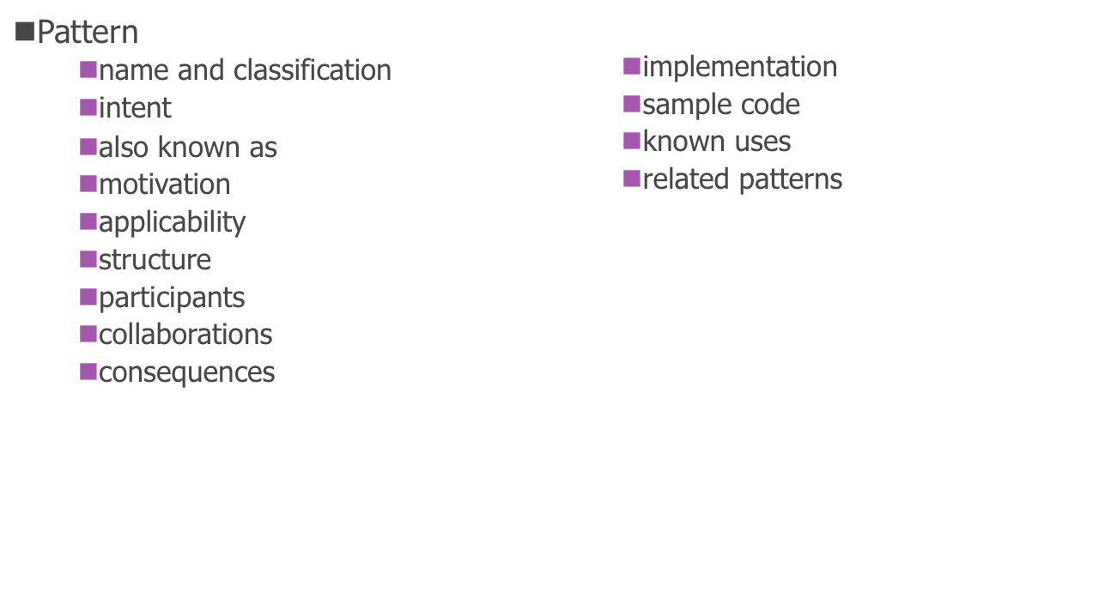
Software Design Patterns
“Descriptions of communicating objects and classes that are customized to solve a general design problem in a particular context” [Gamma, Helm, Johnson, Vlissides 1995]

Slide 10
Patterns Are Designed to Avoid Redesign (caused by…)
Creating an object by specifying a class explicitly
Dependence on specific operations
Dependence on hardware and software platform
Dependence on object representations or implementations
Algorithmic dependencies
Tight coupling
Extending functionality by subclassing
Inability to alter classes conveniently

Slide 11
Patterns Apply Three Design Principles
Program to an interface, not an implementation
  interface should be separately defined, using the construct(s) in the programming language
Favor object composition / delegation over inheritance
Find what varies and encapsulate it
Notes:
with inheritance, can’t change the interface of a superclass bc changes to a superclass will ripple to the subclasses and all classes that use the subclasses
when your goal is code reuse, using composition will yield easier to change code
http://www.javaworld.com/article/2076814/core-java/inheritance-versus-composition--which-one-should-you-choose-.html

Slide 12
Why Study Design Patterns? (I)
Patterns let us
  reuse solutions that have worked in the past; why waste time reinventing the wheel?
  have a shared vocabulary around software design
    they allow you to tell a fellow software engineer, “I used a Strategy pattern here to allow the algorithm used to compute this calculation to be customizable”
      You don’t have to waste time explaining what you mean since you both know the Strategy pattern

Slide 13
Why Study Design Patterns? (II)
Design patterns provide you not with code reuse but with experience reuse
  Knowing concepts such as abstraction, inheritance, and polymorphism will NOT make you a good designer, unless you use those concepts to create flexible designs that are maintainable and that can cope with change
Design patterns can show you how to apply those concepts to achieve those goals

Slide 14
Original Catalogue of Patterns
Purpose
Creational | Structural | Behavioral
Abstract Factory Builder Factory Method Prototype Singleton | Adapter Bridge Composite Decorator Façade Flyweight Proxy | Chain of Responsibility Command Interpreter Iterator Mediator Memento Observer State Strategy Template Method Visitor
Notes:
Creational: used to create objects
Structural: used to integrate existing code into new OO designs
Behavioral: used to manage variations in behavior

Slide 15
Original Catalogue of Patterns
Purpose
Creational | Structural | Behavioral
Abstract Factory Builder Factory Method Prototype Singleton | Adapter Bridge Composite Decorator Façade Flyweight Proxy | Chain of Responsibility Command Interpreter Iterator Mediator Memento Observer State Strategy Template Method Visitor
Patterns I will be talking about in detail; you should read about the others in the book or online.
Notes:
Creational: used to create objects
Structural: used to integrate existing code into new OO designs
Behavioral: used to manage variations in behavior

Slide 16
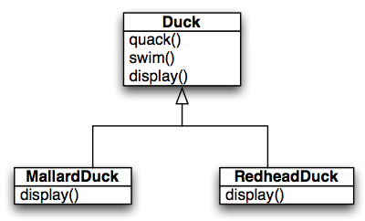
Design Pattern by Example
SimUDuck: a “duck pond simulator” that can show a wide variety of duck species swimming and quacking
  Initial State
But a request has arrived to allow ducks to also fly. (We need to stay ahead of the competition!)
Notes:
showing display() in subclasses indicates that these classes override the superclass’s display() method

Slide 17
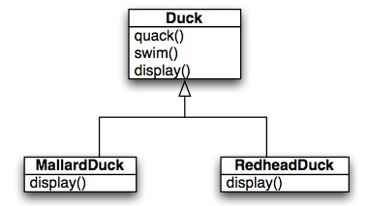
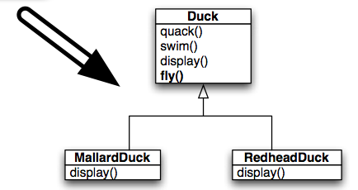
Easy
Code Reuse via Inheritance
Add fly() to Duck; all ducks can now fly

Slide 18
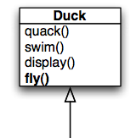
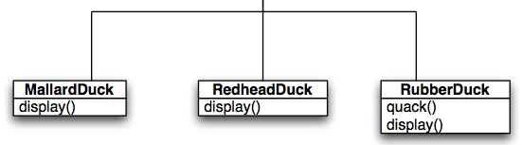
Whoops!
Rubber ducks do not fly! They don’t quack either, so we override quack() to make them squeak
We could override fly() in RubberDuck to make it do nothing, but that’s less than ideal, especially…

Slide 19
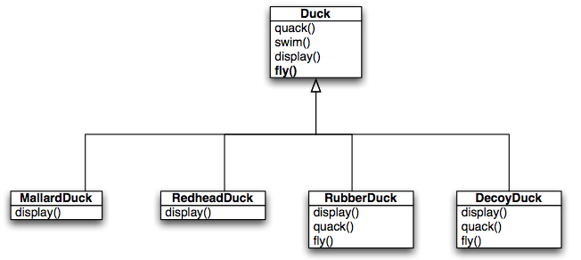
Double Whoops!
…when we might find other Duck subclasses that would have to do the same thing!
What was supposed to be a good instance of reuse via inheritance has turned into a maintenance headache!

Slide 20
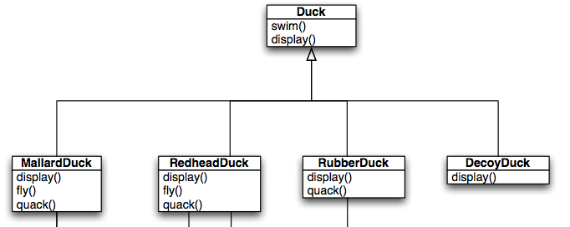
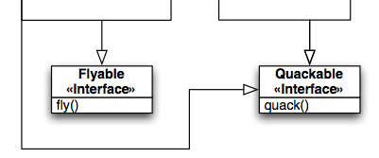
What about an Interface?
Here we define two interfaces and allow subclasses to implement the interfaces they need.
What are the trade-offs?

Slide 21
Design Trade-offs
With inheritance, we get
  code reuse, only one fly() and quack() method vs. multiple (pro)
  common behavior in root class, not so common after all (con)
With interfaces, we get
  specificity: only those subclasses that need a fly() method get it (pro)
  no code re-use: since interfaces only define signatures (con)

Slide 22
Design Principles to the Rescue!
Encapsulate What Varies
  For this particular problem, the “what varies” is the behaviors between Duck subclasses
    We need to pull out behaviors that vary across the subclasses and put them in their own classes (i.e., encapsulate them)
  The result: fewer unintended consequences from code changes (such as when we added fly() to Duck) and more flexible code
Notes:
What needs to be taken out of Duck?

Slide 23
Basic Idea
Take any behavior that varies across Duck subclasses and pull them out of Duck
  Duck will no longer have fly() and quack() methods directly
  Create two sets of classes, one that implements fly behaviors and one that implements quack behaviors
Code to an Interface
  We’ll make use of the “code to an interface” principle and make sure that each member of the two sets implements a particular interface
    For QuackBehavior, we’ll have Quack, Squeak, Silence
    For FlyBehavior, we’ll have FlyWithWings, CantFly, FlyWhenThrown, …
Additional Benefits
  Other classes can gain access to these behaviors and we can add additional behaviors without impacting other classes

Slide 24
“Code to Interface” Does NOT Imply Java Interface
We are overloading the word “interface” when we say “code to an interface”
  We can implement “code to an interface” by defining a Java interface and then have various classes implement that interface
  Or, we can “code to a supertype” and instead define an abstract base class which classes can access via inheritance
When we say “code to an interface” it implies that the object that is using the interface will have a variable whose type is the supertype (whether it is an interface or an abstract base class) and thus
  can point at any implementation of that supertype
  and is shielded from their specific class names
    A Duck will point to a fly behavior with a variable of type FlyBehavior NOT FlyWithWings; the code will be more loosely coupled as a result
Notes:
Abstract classes are similar to interfaces. You cannot instantiate them, and they may contain a mix of methods declared with or without an implementation.
However, with abstract classes, you can declare fields that are not static and final, and define public, protected, and private concrete methods. With interfaces, all fields are automatically public, static, and final, and all methods that you declare or define (as default methods) are public.
In addition, you can extend only one class, whether or not it is abstract, whereas you can implement any number of interfaces.

Slide 25
Bringing it all Together: Delegation
To take advantage of these new behaviors, we must modify Duck to delegate its flying and quacking behaviors to these other classes
  rather than implementing this behavior internally
We’ll add two attributes that store the desired behavior and we’ll rename fly() and quack() to performFly() and performQuack()
  this last step is meant to address the issue of it not making sense for a DecoyDuck to have methods like fly() and quack() directly as part of its interface
    Instead, it inherits these methods and plugs-in CantFly and Silence behaviors to make sure that it does the right things if those methods are invoked
This is an instance of the principle “Favor delegation over inheritance”

Slide 26
New Class Diagram
<<interface>>
FlyBehavior
fly()
flyBehavior
quackBehavior
<<interface>>
QuackBehavior
quack()
Duck
swim()
display()
setFlyBehavior(FlyBehavior)
setQuackBehavior(QuackBehavior)
performFly()
performQuack()
FlyWithWings
fly()
CantFly
fly()
Silence
quack()
Quack
quack()
Squeak
quack()
MallardDuck
display()
RedheadDuck
display()
RubberDuck
display()
DecoyDuck
display()
FlyBehavior and QuackBehavior define a set of behaviors that provide behavior to Duck. Duck delegates to each set of behaviors and can switch among them dynamically, if needed. While each subclass now has a performFly() and performQuack() method, at least the user interface is uniform and those methods can point to null behaviors when required.

Slide 27


FlyBehavior.java and QuackBehavior.java

Slide 28


FlyWithWings.java and Squeak.java

Slide 29
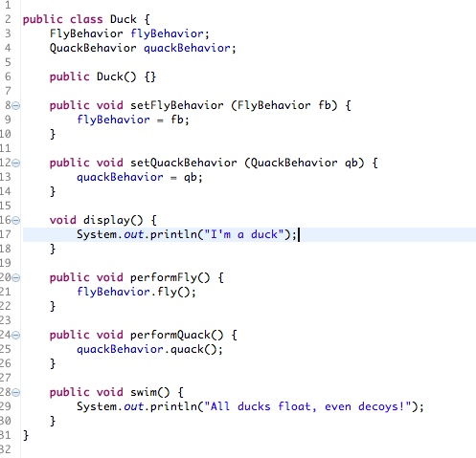
Duck.java
Note: “code to interface”, delegation, encapsulation, and ability to change behaviors dynamically
Notes:
code to interface = using, e.g., quackBehavior.quack() instead of e.g., Squeak.quack()… you’re using the interface’s methods rather than the concrete class’s methods
If you use Squeak.quack() and then you get rid of the Squeak class, you have to change all the references to squeak.

Slide 30
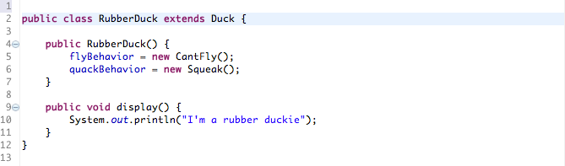
RubberDuck.java

Slide 31
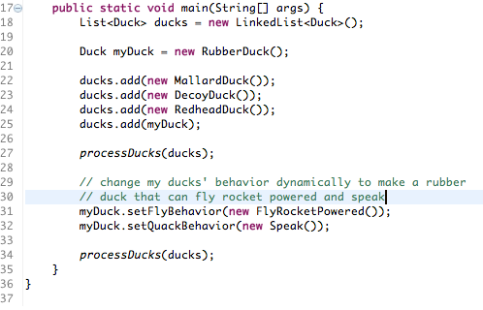
DuckSimulator.java (Part 1)
Note: all variables are of type Duck, not the specific subtypes; “code to interface” in action
Note: here we see the power of delegation. We can change behaviors at run-time

Slide 32
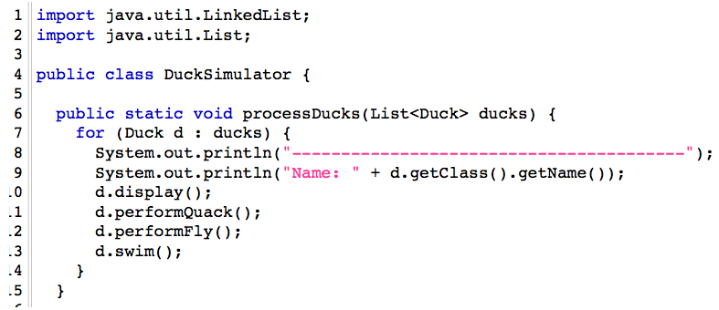
DuckSimulator.java (Part 2)
Because of abstraction and polymorphism, processDucks() consists of nice, clean, robust, and extensible code!

Slide 33
Demo

Slide 34
Not Completely Decoupled
Is DuckSimulator completely decoupled from the Duck subclasses?
  All of its variables are of type Duck
No!
  The subclasses are still coded into DuckSimulator
    Duck myDuck = new RubberDuck();
This is a type of coupling…
  Fortunately, we can eliminate this type of coupling if needed, using a pattern called Factory.
    We’ll see Factory in action in a later lecture

Slide 35
Meet the Strategy Design Pattern
The solution that we applied to this design problem is known as the Strategy Design Pattern
  It features the following design concepts/principles:
    Encapsulate what varies
    Code to an Interface
    Delegation
    Favor Delegation over Inheritance
  Definition: The Strategy pattern defines a family of algorithms, encapsulates each one, and makes them interchangeable. Strategy lets the algorithm vary independently from clients that use it

Slide 36
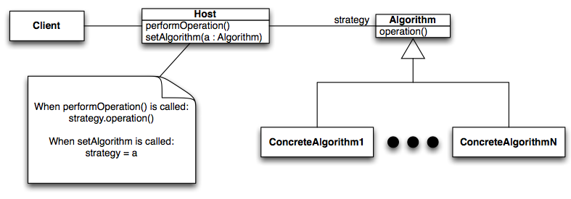
Structure of Strategy
Algorithm is pulled out of Host. Client only makes use of the public interface of Algorithm and is not tied to concrete subclasses.
Client can change its behavior by switching among the various concrete algorithms
Notes:
client = DuckSimulator
host = Duck
Algorithm/strategy = FlyBehavior, QuackBehavior
ConcreteAlgorithms = Quack, Silence, FlyWithWings, etc.

Slide 37
Adapters in the Real World
Our next pattern provides steps for converting an incompatible interface with an existing system into a different interface that is compatible
  Real world example: AC power adapters
  Electronic products made for the USA cannot be used directly with outlets found in most other parts of the world
    To use these products outside the US, you need an AC power adapter

Slide 38
Software Adapters (I)
Pre-condition: You are maintaining an existing system that makes use of a third-party class library from vendor A
Stimulus: Vendor A goes belly up and corporate policy does not allow you to make use of an unsupported class library
Response: Vendor B provides a similar class library but its interface is completely different from the interface provided by vendor A
Assumptions: You don’t want to change your code, and you can’t change vendor B’s code
Solution?: Write new code that adapts vendor B’s interface to the interface expected by your original code

Slide 39
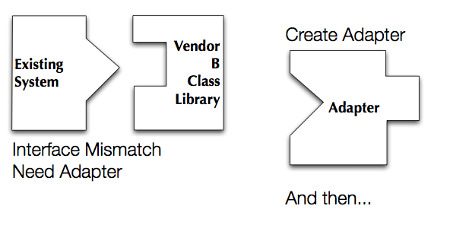
Software Adapters (II)

Slide 40
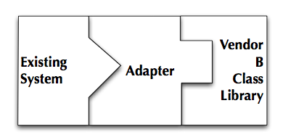
Software Adapters (III)
…plug it in
Benefit: Existing system and new vendor library do not change—new code is isolated within the adapter

Slide 41
Example: A Turkey Amongst Ducks! (I)
If it walks like a duck and quacks like a duck, then it must be a duck!

Slide 42
Example: A Turkey Amongst Ducks! (I)
If it walks like a duck and quacks like a duck, then it must be a duck!
Or…
It might be a turkey wrapped with a duck adapter!

Slide 43

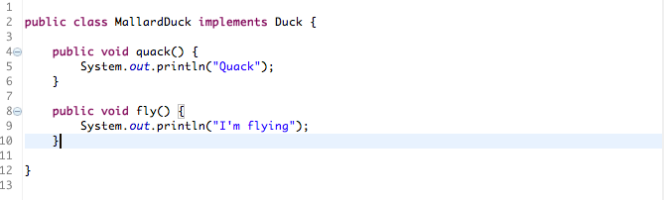
Example: A Turkey Amongst Ducks! (II)
A slightly different duck model

Slide 44
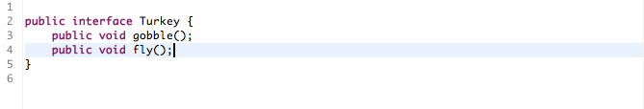
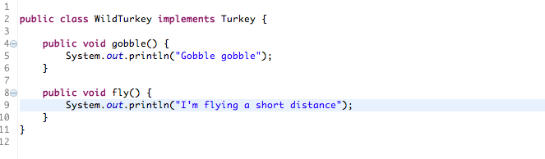
Example: A Turkey Amongst Ducks! (III)
An interloper wants to invade the simulator
But the duck simulator doesn’t know how to handle turkeys, only ducks!

Slide 45
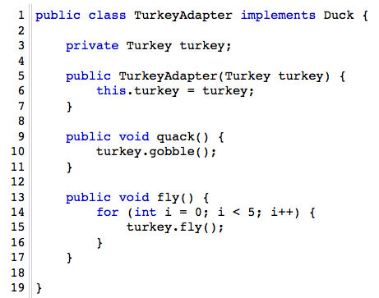
Example: A Turkey Amongst Ducks! (IV)
Solution: Write an adapter that makes a turkey look like a duck
1. Adapter implements target interface (Duck)
2. Adaptee (turkey) is passed via constructor and stored internally
3. Calls by client code are delegated to the appropriate methods in the adaptee
4. Adapter is full-fledged class, could contains additional vars and methods to get its job done; can be used polymorphically as a Duck

Slide 46
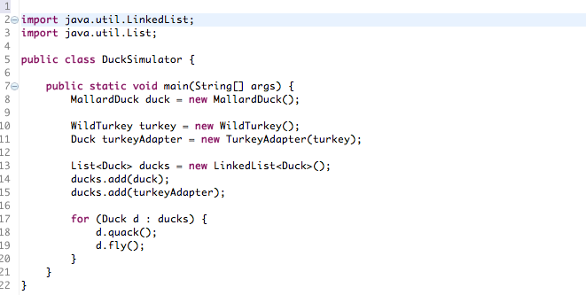
DuckSimulator.java

Slide 47

Demo

Slide 48
Adapter Pattern: Definition
The Adapter pattern converts the interface of a class into another interface that clients expect. Adapter lets classes work together that couldn’t otherwise because of incompatible interfaces.
  The client makes a request on the adapter by invoking a method from the target interface on it
    quack()
  The adapter translates that request into one or more calls on the adaptee using the adaptee interface
    turkey.gobble()
  The client receives the results of the call and never knows there is an adapter doing the translation

Slide 49
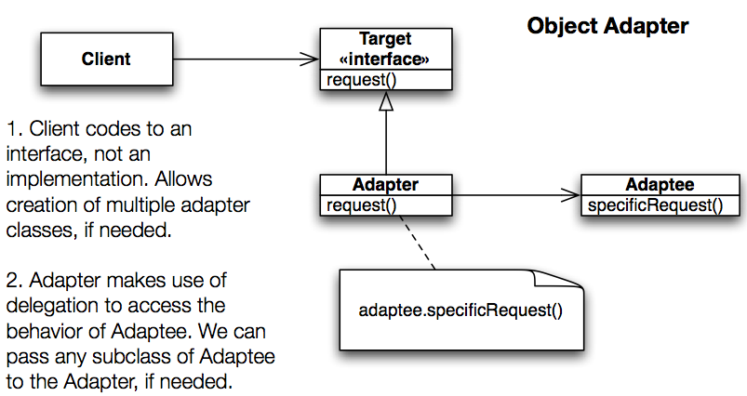
Adapter Pattern: Structure
Notes:
client = DuckSimulator
Target interface = Duck interface
Adapter = TurkeyAdapter
request = quack()
Adaptee = Turkey
specificRequest = gobble()

Slide 50
Next Time
More patterns!

